Slide 1
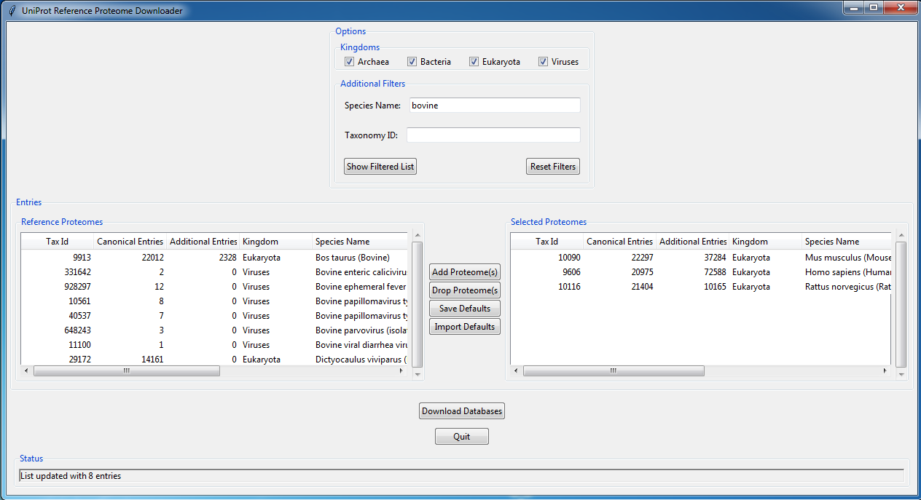
User’s Guide: reference_proteome_manager.py July 2017

Slide 2
What is reference_proteome_manager?
A GUI Python application to download and manage UniProt reference proteomes
Written by Delan Huang and Phil Wilmarth, OHSU
Available at GitHub:https://github.com/Delan-Huang/Reference_Proteome_Manager
System requirements: Python 3 (developed and tested with v3.6) and an internet connection

Slide 3
What are UniProt reference proteomes?
High quality, complete proteomes that span the tree of life
See: http://www.uniprot.org/help/reference_proteome
Reference proteome statistics (July 2017):
Phylogenetic Kingdom | Number of proteomes
Archaea | 372
Bacteria | 6521
Eukaryota | 993
Viruses | 506

Slide 4
How to get reference proteomes?
Reference proteomes are available from UniProt main web pages and at the Proteomes page: http://www.uniprot.org/proteomes/
They are available via FTP at: ftp://ftp.uniprot.org/pub/databases/uniprot/current_release/knowledgebase/reference_proteomes/
Designation of canonical sequences and associated isoforms, and annotation of isoforms are superior for the FTP files
Reference proteome naming and multiple files per species make the FTP site challenging to navigate

Slide 5
reference_proteome_manager helps
The App presents reference proteomes in an informative graphical user interface (GUI)
Reference proteomes are designated by species names and searching and filtering of the 8000+ proteomes is supported
Sets of user-defined default organisms are supported to facilitate frequent downloading of common proteomes
Locating FTP files and downloading is automated
Reference proteome naming and file organization are standardized

Slide 6
How to run reference_proteome_manager
Two files are needed: reference_proteome_manager.py and fasta_lib_Py3.py
The two files should be in the same folder and that folder can be located anywhere
Python version 3 is required (3.6 is current release)
https://www.python.org/downloads/
https://www.continuum.io/downloads
Application can be ran from command line or integrated programming environment editor windows
There are many online resources for how to run python scripts

Slide 7
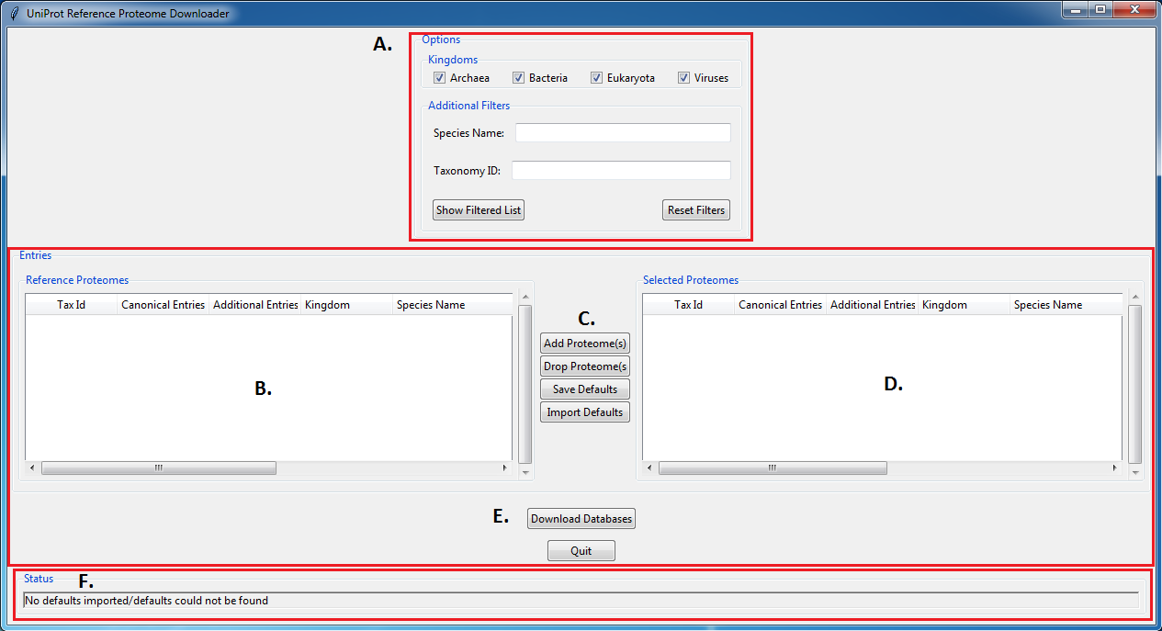
Overview
The general program flow is as follows:
Select kingdom filters and type in any partial species word/phrase or taxonomy number into respective search fields and press the “Show Filtered List” button to display all relevant databases in the left “Reference Proteome” table.
Select one or more proteomes from the left table and use the “Add Proteome(s)” button to add databases to the “Selected Proteomes” table on the right. “Selected Proteomes” can be downloaded.
Note the “Save Defaults” and “Import Defaults” buttons. These buttons allow the user to save current selections in the right display table to a defaults file, or import databases of interest from a previously saved defaults file.
This “Selected Proteomes” table shows all selected databases that the user wants to download.
Press “Download Databases” to download all selected FASTA files.
F. This status bar will display information about changes to either display table including adding/dropping proteomes, refiltering the database list, and downloading file progress.

Slide 8
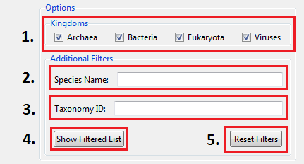
Filters Description
The “Kingdoms” checkboxes allow the user to narrow database list by the phylogenetic kingdom their species belongs to.
The “Species Name” search bar allows the user to type in either a partial word/phrase or complete word/phrase that match the name of the desired species.
The “Taxonomy ID” search bar allows the user to type in either a full or partial taxon number that matches their desired species.
The “Show Filtered List” button will output all species that match the desired filters.
The “Reset Filters” button will clear all search bars and re-select all kingdoms.
Note: No kingdoms checked is interpreted as all kingdoms. Blank species and taxonomy filters are ignored.

Slide 9
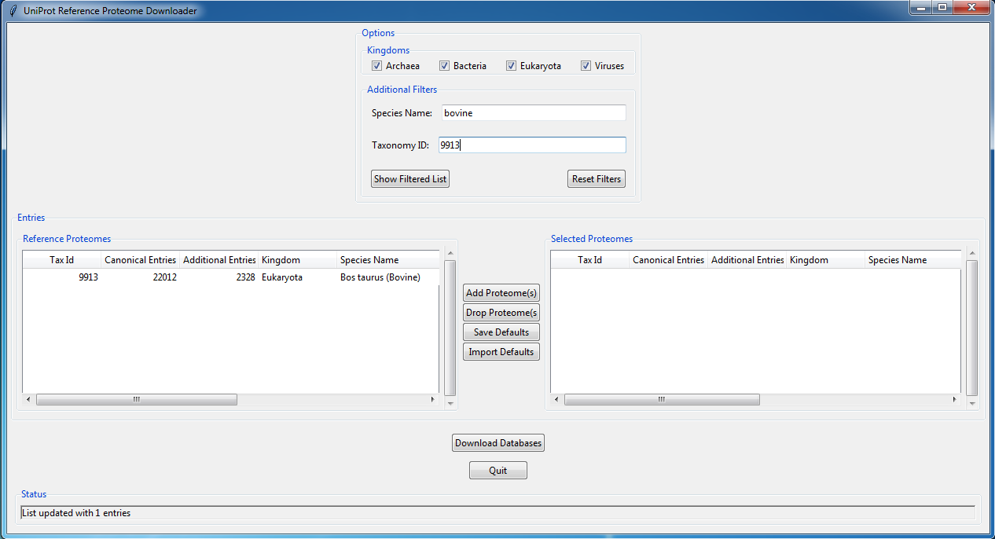
Filters Example
Here I have left all kingdoms selected, but searched using the entries “bovine” and “9913” which outputted only one species, the Bos taurus database.

Slide 10
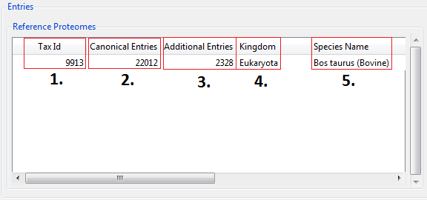
Display Tables Description
“Tax Id”: outputs the taxonomy number of the species.
“Canonical Entries”: outputs the number of canonical sequences in the database
“Additional Entries”: outputs the number of isoform sequences in the database
“Kingdom”: outputs the kingdom the species belongs to
“Species Name”: outputs the species name
Note: All of these headers can be extended. Furthermore, clicking on the header will sort the database list either alphabetically or numerically depending on the header. Also, all of these descriptions are the same for both display tables (Reference Proteomes and Selected Proteomes)

Slide 11
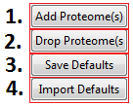
List Management Buttons
“Add Proteome(s)”: moves database(s) from the left display table to the right display table (Reference Proteomes → Selected Proteomes).
“Drop Proteome(s): moves database(s) from the right display table to the left display table (Reference Proteomes ← Selected Proteomes).
“Save Defaults”: saves all databases in the right display table (Selected Proteomes) to a directory the user selects.
“Import Defaults”: imports the databases stored in a defaults file to the right display table (Selected Proteomes)

Slide 12

Operational Buttons
“Download Databases”: downloads all of the databases shown in the Selected Proteomes display table to the user selected folder. Currently, the app is configured to download only protein *.fasta.gz and *_additional.fasta.gz files from the UniProt FTP download site.
The program will save all selected databases into a common “UniProt_(date)” folder, where “date” is the release date of the databases ie. 2017.07.
Each database will have its own folder named in the following convention “(date)_(proteome ID)_(Species Name)”.
The *.gz files are then unzipped and a *_all.fasta file and *_canonical.fasta file are placed in the common UniProt folder.
The naming convention for these files is “(proteome ID)_(taxonomy ID)_(species name)_all.fasta” or “(proteome ID)_(taxonomy ID)_(species name)_canonical.fasta”.
*_all.fasta file includes both canonical and isoform sequences.
“Quit”: will exit the program. If any changes have been made to the Selected Proteomes display table, the user will be prompted to save the current proteome list to a new defaults file.

Slide 13
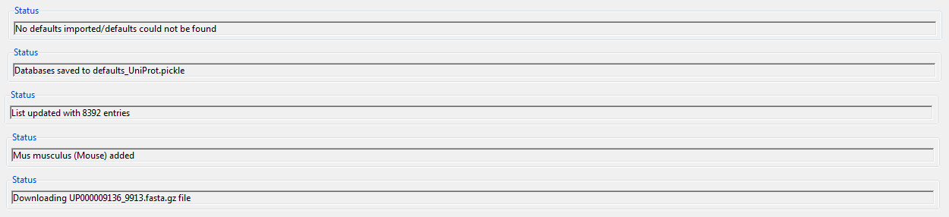
Status Bar Updates
These are some common messages that the status bar will provide as the user interacts with the program.

